Slide 1
One Way : Timed BPMN 2.0
Timed execution semantics & model-checking
LE ROUX Luka @ ENSTA Bretagne

Slide 2
Introduction
Timed Constraints
Model BPMN 2.0
Requirements
Temporal logic
Atomic propositions
Dwyers Patterns
Timed BPMN Execution Semantics
?
Model-checking

Slide 3
Plan
BPMN 2.0 Execution Semantics (One Way subset)
Timed Extension
Intuition
Difference Bound Matrix
Demo
Conclusion & future work

Slide 4
Semantics : OBP2 & PragmaDev Process
Differences :
Model-checking versus simulation as main use case
Big steps versus small steps semantics
Symbolic versus explicit time representation
Commonalities :
Standard compliant
Weakly bi-simulable (preserve reachability)

Slide 5
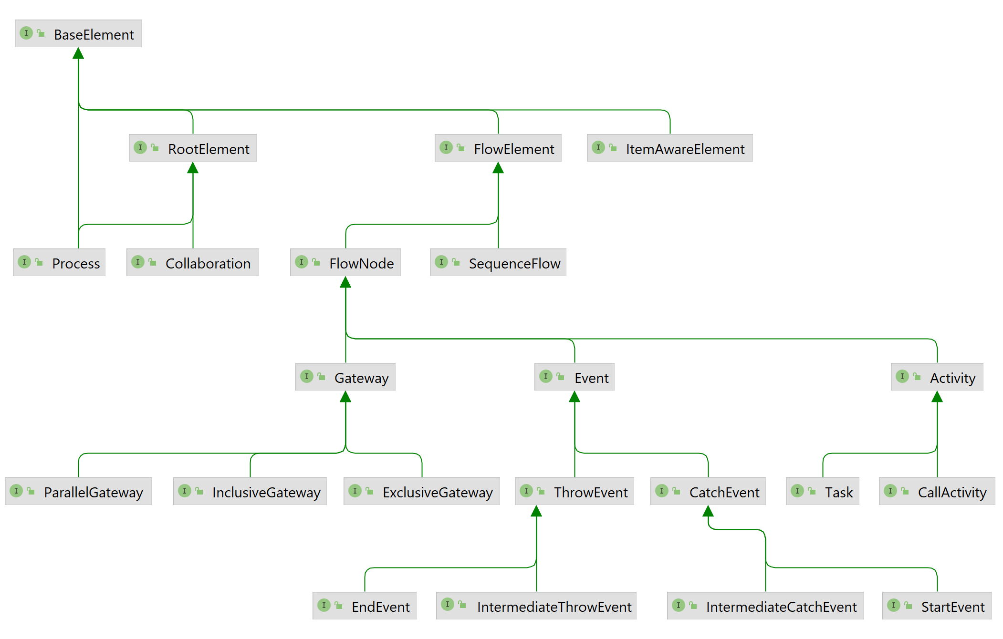
BPMN 2.0 Meta-Model (subset)
Root Element
Collaboration
Process
Flow Elements
Sequence Flow
Flow Node
Gateways
Events
Activities
Data
Item-Aware Elements

Slide 6

Execution Semantics – Tokens
« The behavior of process elements can be defined by describing how they interact with a token as it traverses the structure of the process. »
Similar to program pointer in the context of imperative programming
Places : Sequence flows (ex: 1 & 2) and simple Tasks (ex: DoSomething)
Notes:
Préciser la notion de pointeur de programme pour les non informaticiens?
Notion de token non nécessaire pour respecter le standard
Liens avec les proposition atomiques

Slide 7
Execution Semantics – Tokens
{ }
{ 2 }
{ 1 }
{ DoSomething }

Slide 8
Execution Semantics – Tokens
An execution starts with tokens on sequence flows outgoing from participants’ (root process(es)) unconditional start events
An execution ends properly if no tokens are left
{ 1 } → { DoSomething } → { 2 } → { }
Notes:
Bien introduire la notion de configuration
Evoquer la différence avec PragmaDev Process

Slide 9
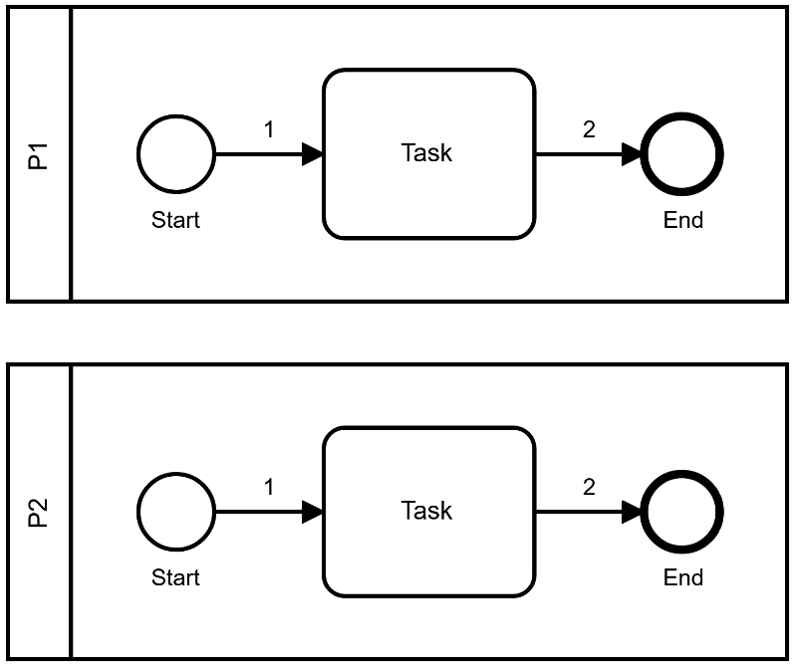
Execution Semantics – Collaboration
{ P1@1 P2@1 }
{ P1@T P2@1 }
{ P1@1 P2@T }
{ P1@2 P2@1 }
{ P1@T P2@T }
{ P1@1 P2@2 }
{ P2@1 }
{ P1@2 P2@T }
{ P1@T P2@2 }
{ P1@1 }
{ P2@T }
{ P1@2 P2@2 }
{ P1@T }
{ P2@2 }
{ P1@2 }
{ }
Notes:
Fenêtre sur le model-checking
Si j’ai le temps, rajouter les tokens lors de l’animation

Slide 10
Execution Semantics – Gateways
Parallel :
Activated if there is at least one token on each incoming flows
Consumes exactly one token from each incoming flows (join)
Produces exactly one token at each outgoing flows (fork)
Exclusive (with exactly one outgoing flow) :
Activated if there is at least one token on one incoming flow
Consumes exactly one token from one incoming flow
Produces exactly one token at its one outgoing flow

Slide 11
Execution Semantics – Gateways
Inclusive :
Binds subsets of incoming flows to subsets of outgoing flows
All conditions that evaluate to true yield a token on their flows
Both rely on conditions attached to outgoing flows
Exclusive (with multiple outgoing flows) :
Each activation, produces at most one token
Conditions are evaluated in order, the first condition that evaluates to true yield a token on its flow

Slide 12
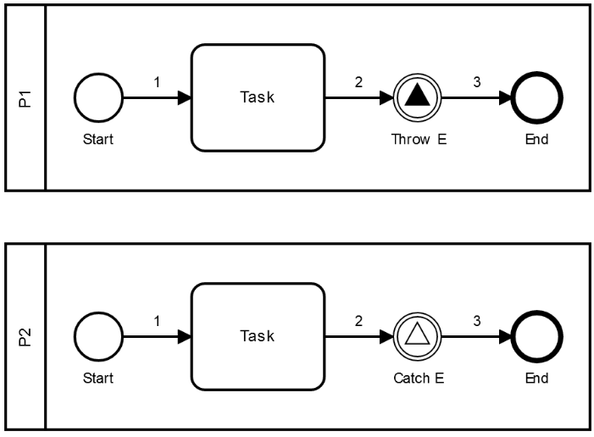
Execution Semantics – Signals
A throw event activates when there is a token on its incoming flow
A catch event activates when there is a token on its incoming flow and a matching throw event activates
Consumes one token from the throw event incoming flow and all tokens on matching catch events incoming flows
Produces one token at the throw event outgoing flow and as many tokens as consumed at matching catch events outgoing flows
Start (resp. End) events can also catch (resp. throw)

Slide 13
Execution Semantics – Signals
Participant P2 reaches 2 soon enough :
… → { P1@2 P2@2 } → { P1@3 P2@3 } → … → { }
Can lead to deadlocks (a catch event may never activate with a token on its incoming flow)
Participant P1 throws its event too early (deadlock) :
… → { P1@2 P2@T } → { P1@3 P2@T } → … → { P2@2 }

Slide 14
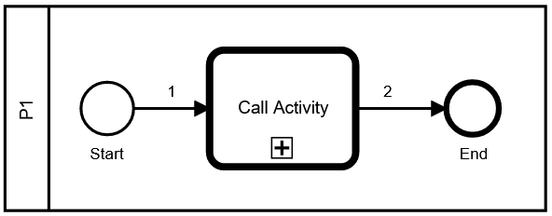
Execution Semantics – Call Activity
References a process to be executed upon activation (if not, behaves like a simple task)
When entered, consumes one token from one of its incoming flows
When entered, produces on token on flows following a start event within the called process
Tokens within a called process are also identified by their call activity (stack trace)
When the called process ends, produces a token at each of the call activity outgoing flows

Slide 15
Plan
BPMN 2.0 Semantics (One Way subset)
Timed Extension
Intuition
Difference Bounded Matrix
Demo
Conclusion & future work

Slide 16
Meta Model Extension – Timed Constraints
Attached to tasks
Provided (so far) as constants or triangular distributions with values for minimum, maximum and mode (denotes the most likely outcome)
Exemple : min = 29, max = 43, mode = 36
0
29
36
43

Slide 17
Meta Model Extension – Timed Constraints
For non-probabilistic reachability concerns, mode is irrelevant
Thus, constraints can be represented as intervals
If min <> max, a triangular distribution excludes its bounds (P(t) = 0)
Ex : [5, 5] (from a constant) & ]29, 43[ (from a triangular distribution)
0
29
36
43
Notes:
i.e. analyse au pire cas

Slide 18
Timed Execution Semantics – Intuition
]1, 2[
Execution :
Initial configuration : { 1 } , elapsed : [0, 0]
Task active : { T } , elapsed : [0, 2[
Task closed : { 2 } , elapsed : ]1, 2[
Process finished : { } , elapsed : ]1, oo[
Generic rules:
If a sequence flow can be traversed, time is frozen
A task can be active up to its maximum
( upper bound may increase when tasks are active )
A task can not end before its minimum is reached
( lower bound may increase when a task closes )

Slide 19
Timed Execution Semantics – Collaboration
Configurations :
Elapsed time :
{ P1@1 P2@1 }
[0, 0]
{ P1@T P2@1 }
{ P1@1 P2@T }
]1, 2[
[0, 2[
{ P1@T P2@T }
{ P1@2 P2@T }
{ P1@T P2@2 }
]1, 2[
{ P2@T }
{ P1@2 P2@2 }
{ P1@T }
]1, 2[
{ P2@2 }
{ P1@2 }
{ }
]1, oo[

Slide 20
Timed Execution Semantics – Gateways & Events
If a sequence flow can be traversed, time is frozen
Corollary : if no sequence flow can be traversed, time may advance
Parallel gateway : if an incoming flow is missing, time may advance regardless of tokens on other incoming flows to that gateway
Events : If a signal can not be thrown, time may advance regardless of tokens on incoming flows to matching catch events

Slide 21
Timed Execution Semantics – Gateways & Events
Configurations :
Elapsed time :
{ P1@1 P2@1 }
[0, 0]
{ P1@T P2@1 }
{ P1@1 P2@T }
]3, 4[
{ P1@T P2@T }
[0, 2[
{ P1@T P2@2 }
]1, 4[
{ P1@2 P2@2 }
]3, 4[
{ P1@3 P2@3 }
]1, 2[
{ P2@3 }
{ P1@3 }
{ }
]3, oo[

Slide 22
Timed Execution Semantics – Gateways & Events
Configurations :
Elapsed time :
{ P1@1 P2@1 }
[0, 0]
{ P1@T P2@1 }
{ P1@1 P2@T }
]1, 2[
{ P1@T P2@T }
[0, 2[
{ P1@2 P2@T }
]1, 2[
{ P1@3 P2@T }
{ P2@T }
]1, 4[
]3, 4[
{ P2@2 }
]3, oo[

Slide 23
Timed Execution Semantics – Clocks
Global elapsed time is not sufficient to decide what happens next
Instead:
A clock is defined for each active token, it tells how long its token has been present
When time changes, it does so evenly for all clocks
For the abstraction to be precise, we also need to keep track of the differences between clocks

Slide 24
Timed Execution Semantics – Clocks
Ex : ( { P1@T P2@T } , { c0:[0, 2[ , c1:[0, 2[ , c1-c0:[0,0] } )
{ P1@T P2@T } : the set of tokens
c0:[0, 2[ , c1:[0, 2[ : for each token, the time elapsed since present
c1-c0:[0,0] : for each two tokens, the time difference
[0, 0] : c0 and c1 are equal
[1, 1] : c1 is greater than c0 by exactly 1 time unit
[n, m] : difference of at least n and at most m time units

Slide 25
Timed Execution Semantics – DBM
Ex : ( { P1@T P2@T } , { c0:[0, 2[ , c1:[0, 2[ , c1-c0:[0,0] } )
P2@T
 |  | P1@T | P2@T
 |  | < 2 | < 2
P1@T | >= 0 |  | <= 0
P2@T | >= 0 | >= 0
2
Difference Bound Matrix
(DBM)
0
2
P1@T

Slide 26
Timed Execution Semantics – DBM
Ex : ( { P1@T P2@T } , { c0:[0, 2[ , c1:[0, 2[ , c1-c0:[0,1[ } )
P2@T
 |  | P1@T | P2@T
 |  | < 2 | < 2
P1@T | >= 0 |  | < 1
P2@T | >= 0 | >= 0
2
Difference Bound Matrix
(DBM)
0
2
P1@T

Slide 27
Difference Bounded Matrix – Execution Step
How to update the DBM given a model, a source configuration, a transition :
Minimum bounds are updated according to the transition’s guard (when a task closes, the minimum time this task needs to be active)
Clocks of consumed tokens are removed, clocks are introduced for each produced tokens (hence, if a token moves, its clock is reset)
Maximum bounds are updated according to the target’s invariant (how much can time advance given the set of tokens and current valuation of clocks)

Slide 28
Timed Verification & Properties
Timed constraints restrict possible executions, thus a property that fails without these may now pass (ex: events & deadlock)
New atomic propositions :
Global elapsed time (ex: TTM < 42)
Elapsed time between two observable events (ex: a token appears, a process starts, a task closes, a signal is thrown, …)

Slide 29
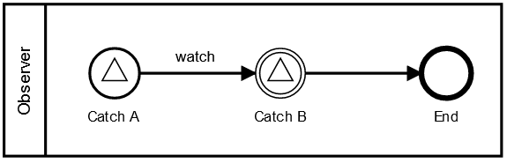
Timed Verification & Properties
Req : « Signal B must answer to A in less than 21 time units »
Generated observer :
(intuition)
Generated property : [] | c_watch < 21 |
With:
« [] … » the LTL formula
« c_watch » the clock associated to « watch » sequence flow
« | c_watch < 21 | » an atomic proposition

Slide 30
Plan
BPMN 2.0 Semantics (One Way subset)
Timed Extension
Intuition
Difference Bounded Matrix
Demo
Conclusion & future work

Slide 31
Conclusion
Contributions :
BPMN 2.0 Execution Semantics (standard compliant)
Verification of temporal formulas
Timed constraints interpreted as intervals
Atomic propositions covering base BPMN concepts and time
Future work :
Finalize implementation within OBP2
Enlarge supported BPMN subset (messages, data, …)
Explore similar opportunities with PragmaDev Process
Reflexions about probabilistic reachability

Slide 32
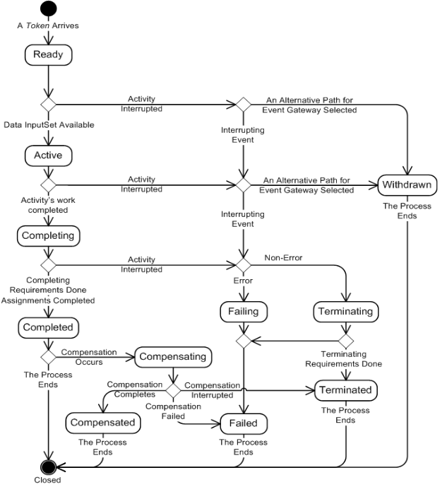
BPMN 2.0 Execution Semantics – Task Lifecycle

Slide 33
Timed Execution Semantics – Clocks
Tokens :
Associated Clocks :
Difference :
{ P1@1 P2@1 }
[0,0] [0,0]
[0,0]
{ P1@T P2@1 }
[0,0] [0,0]
[0,0]
]1, 2[
{ P1@T P2@T }
[0,2[ [0,2[
[0,0]
{ P1@T P2@2 }
]1,2[ [0,0]
]1,2[
{ P1@2 P2@2 }
[0,0] [0,0]
[0,0]
]1, 2[
{ P1@2 }
[0,0]
{ }

Slide 34
Static analysis versus model-checking
Static analysis may be enough to answer some questions such as :
« Will my process end before x unit of time »
However :
Model-checking may be necessary once data are taken into account
Time also restricts some executions (ex : deadlock)

